Slide 1

Senior Design Project I
Weeks 3-4: A Different Spin on ASL Translation
Presenter: Josheb P. Dayrit
Notes:
My project is still about sign language translation. However, I won’t be using a neural network for that purpose anymore.

Slide 2

No More Neural Network Shenanigans?
Why?
Datasets for most gestures are scarce and hard-to-come-by. More datasets = more accuracy.
You cannot locally train an AI with many layers. You will run into RAM problems.
Images and videos vary widely in resolution. Having images or videos with good resolution is paramount to getting a properly trained AI.
Notes:
So, why did I abandon the neural network idea? There are 3 reasons.
First, the datasets. For a lot of gestures, these are hard-to-come-by.
Second, RAM problems. Your laptop or PC might not have enough memory to train a neural network.
And last, resolution. We need images and videos with good resolution. However, we won’t always have good images or videos.
And that’s a problem.

Slide 3
New Ideas? You Bet!
(Surface) Electromyography (EMG)
Mechanomyography (MMG)
Notes:
I did come up with alternative ideas, and they are related to these 2 scientific topics.

Slide 4
“Electro”-my-“ography”? English, Please.
Electromyography? ASL?
When you make gestures (ASL or otherwise), your muscles contract.
Motor neurons transmit the electric signals necessary to tell your muscles to contract.
EMG devices (electrodes, basically) placed on skin close to the desired muscles can translate electric signals into sounds, graphs, or numerical values for evaluation by a medical specialist.

Slide 5
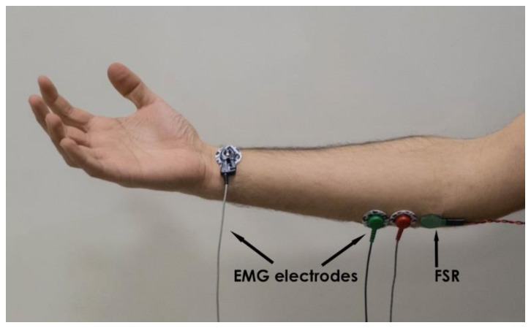
“Electro”-my-“ography”? English, Please.

Slide 6
“Electro”-my-“ography”? English, Please.
More on Electromyography
Basically, we’re converting ASL gestures, which cannot be quantified, into electrical signals, which can be quantified.
Expectation: Certain ASL gestures will correspond to specific potential readings.
Numbers are friends.
Notes:
What if two or more potential readings are the same?

Slide 7
Did You Say “Mecha”? I Love Gundam.
Mechanomyography?
There are mechanical footprints, in addition to electrical ones.
Muscle contraction is generally associated with:
increase of stiffness (in muscles),
increase of tension,
mechanical vibrations, and other mechanical parameters.
What MMG devices can measure: muscular vibrations of an active muscle, stiffness (indirectly measured through the forces exerted by the muscles).
Stiffness is what we’re going to focus on.
Notes:
Mechanomyography is going to be our failsafe.

Slide 8
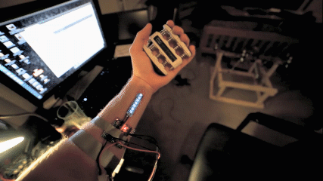
Did You Say “Mecha”? I Love Gundam.

Slide 9
Did You Say “Mecha”? I Love Gundam.
Mechanomyography and ASL
In MMG, strain gauges are used for measuring stiffness.
The variance in resistance indicates changes in stiffness.
Expectation: The variance in resistance is different for each ASL gesture. This will, in theory, allow us to classify the gestures numerically and tell them apart.

Slide 10
Reference(s)
[1] Esposito, D., Andreozzi, E., Fratini, A., Gargiulo, G., Savino, S., Niola, V. and Bifulco, P. (2018). A
Piezoresistive Sensor to Measure Muscle Contraction and Mechanomyography. [online]
Available at: https://www.ncbi.nlm.nih.gov/pmc/articles/PMC6111775/#B1-sensors-18-02553
[Accessed 18 Sep. 2019].
[2] Gperco.com. (2013). 12 Hour Project: Arduino Mechanomyography. [online] Available at:
http://www.gperco.com/2013/11/12-hour-project-arduino-mechanomyography.html [Accessed 18 Sep.
2019].

